Slide 1
Multi-Altiz Alignment
Calibration Tool
One line

Slide 2
Sketch 2D model one line
For information only. Dimensions are subject to change.
360mm
15mm
70mm
60mm
40mm
60mm
40mm
60mm
40mm
60mm

Slide 3
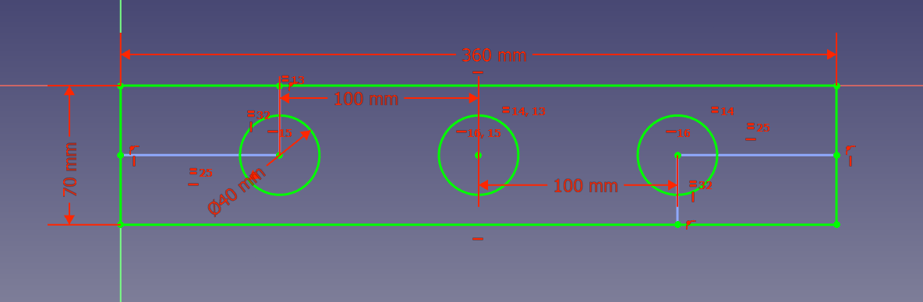
Sketch 2D model
For information only. Dimensions are subject to change.

Slide 4
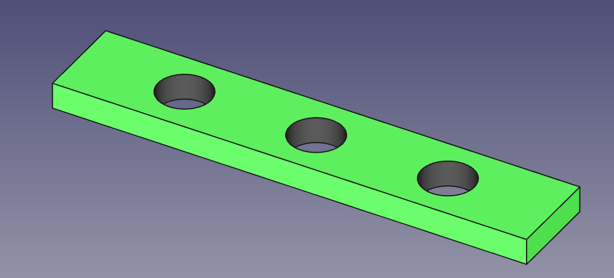
3D model

Slide 5

Material
The tool should have a matte finish to reduce reflections. Matte paint can be used:

Slide 6

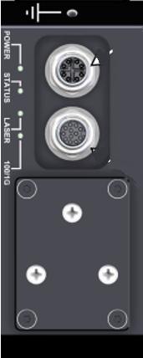
Constraints (1)
The Altiz must be ordered with the main camera at one end.
Example:
Output Input
Output Input
Output Input
Output Input
Main
Secondary 1
Secondary 2
Secondary 3
Secondary 4
Input Output
Input Output
Input Output
Input Output
Secondary 4
Secondary 3
Secondary 2
Secondary 1
Main

Slide 7

Constraints (1)
Input
Output
Input
Output
Output
Input
Output
Secondary 4
Secondary 2
Secondary 1
Secondary 3
Main
Input
Output
Input
Output
Output
Input
Output
Input
Secondary 4
Secondary 3
Main
Secondary 1
Secondary 2

Slide 8
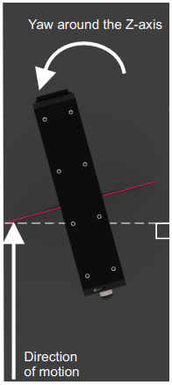
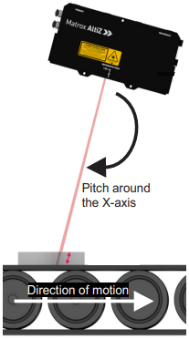
Constraints (2)
The Altiz should not have any rotation around their X and Z axis.

Slide 9
Constraints (3)
Grab must only be performed on the Main camera.
Plugin support a maximum of 6 Altiz.

Slide 10
Installation (1)
Required:
MIL X 23H2 and U149 minimum .
SP7 minimum.
Image Processing module license.
To add a plugin in Capture Works:
Download the plugin Zip folder on GitHub. (see next slide)
Unzip. Inside you’ll find a PowerShell script (.ps1) and a folder containing the plugin.
Open PowerShell as an administrator.
Use the “cd” command to navigate to the directory containing your PowerShell script.
Write .\MultiAltizInstallScript.ps1 and press enter. The script will check:
Python installed in your machine.
pip package install.
Mil Python package. If not, it will install it.
Once all checking are done it will copy the plugin folder in CaptureWorksPlugin folder.

Slide 11
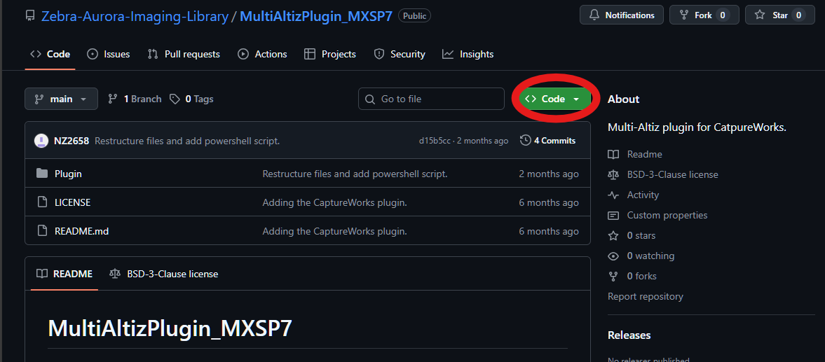
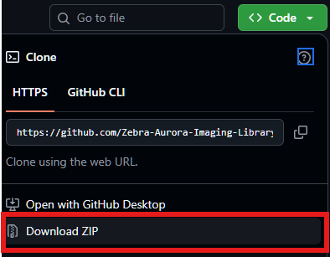
Installation (2)
Download the plugin Zip folder on GitHub
1- Click on “Code”:
2- Click on “Download ZIP”

Slide 12


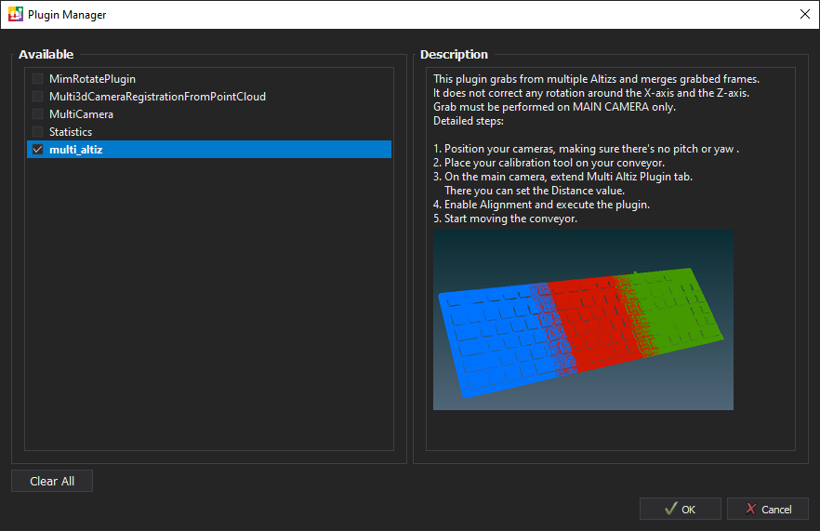
User guide
After opening CaptureWorks open the “Plugin manager” :
Select “multi_altiz” then clic on OK

Slide 13
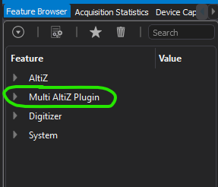
User guide
Allocate each secondaries camera and then allocate the main camera. You should see a new tab called “Multi AltiZ Plugin”:

Slide 14
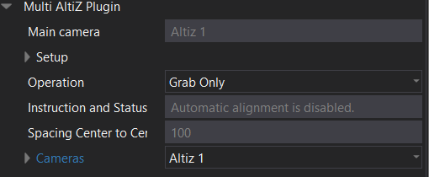
User guide
Extend the Multi AltiZ Plugin tab to see all the features it contains. (1)
Plugin’s name.
Main camera name.
Sub tab allowing the user to set the plugin’s parameters.
Set whether you want to perform alignment.
Instruction and status of alignment.
Sets the distance between the holes along Altiz’s X-axis.
Control cameras parameters.

Slide 15
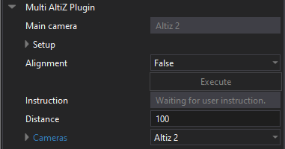

User guide
Extend the Multi AltiZ Plugin tab to see all the features it contains. (2)
Based on the IO, the plugin will automatically find topology and identifies the main camera (when it is allocated).

Slide 16
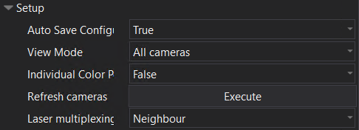
User guide
Extend the Multi AltiZ Plugin tab to see all the features it contains. (3)
Sub tab allowing user to set plugin’s parameters.
Selects whether you want to save settings in a camera.
Note that when activated, it slows the plugin just before the grab. Make sure the “Acquisition…” status is on before moving the stage.
Keep the data of all the grabs and not only the merge.
Assign a unique color per PC grabbed by each AltiZ.
Refresh values on the feature browser.
Setup the laser multiplexing mode: - Neighbour (default)
- Off
- Custom

Slide 17
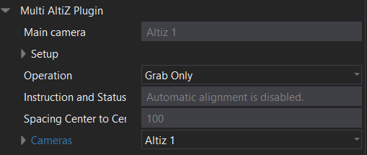
User guide
Extend the Multi AltiZ Plugin tab to see all the features it contains. (4)
Set whether you want to perform alignment. When feature is set to “Alignment”, simply press the Single Grab button to performs the grab and alignment. Or set this feature to “Grab Only” when an alignment has already been made. The conveyor can be moved.

Slide 18
User guide
Extend the Multi AltiZ Plugin tab to see all the features it contains. (5)
Indicates if the plugin is ready to align or not.

Slide 19
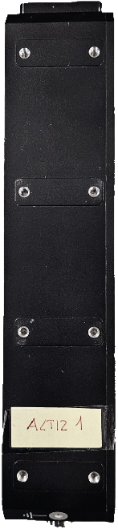
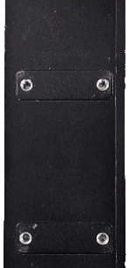
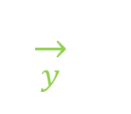






Extend the Multi AltiZ Plugin tab to see all the features it contains. (6)
Set the distance between the holes along Altiz’s X-axis from the main camera.
Main
Secondary 1
Secondary 2
40mm
100 mm
40mm
$$\overset{→}{x}$$
100 mm
40mm
$$\overset{→}{x}$$
$$\overset{→}{y}$$
$$\overset{→}{y}$$
$$\overset{→}{x}$$
$$\overset{→}{y}$$

Slide 20






Extend the Multi AltiZ Plugin tab to see all the features it contains. (6)
Secondary 2
Secondary 1
Main
40mm
100 mm
40mm
$$\overset{→}{x}$$
100 mm
40mm
$$\overset{→}{x}$$
$$\overset{→}{y}$$
$$\overset{→}{y}$$
$$\overset{→}{x}$$
$$\overset{→}{y}$$

Slide 21
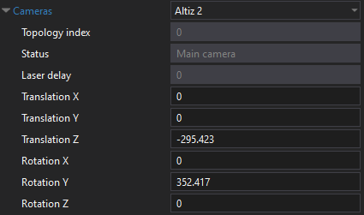
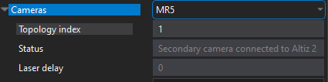
Extend the Multi AltiZ Plugin tab to see all the features it contains. (7)
Control cameras parameters.
Indicates position of the selected camera in the topology.
Indicates whether the selected camera is the main camera. If not, it indicates which camera it is connected to.
Transformation values for the alignment. Automatically filled after an alignment but the user can enter his own values.
The transformation values are relative to the main camera frame.
Example of a secondary camera.

Slide 22
Setup time
Step 1: Position the cameras, making sure there's no pitch or yaw by using the setup view on CaptureWorks that will only shoot the laser.
Step 2: Place the calibration tool on the conveyor. The calibration tool doesn’t have to be perpendicular to direction of motion. One hole should be under each camera. If there is Roll around the Y-axis, it is ok if the camera sees more than one hole.

Slide 23
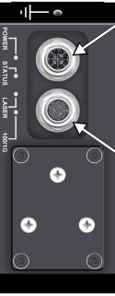
Section of the calibration tool using Medium Altiz
Main Altiz
Secondaries

Slide 24
Section of the calibration tool using Small Altiz
Main Altiz
Secondaries

Slide 25
Runtime (Alignment ON)
Step 1: In the same instance of CaptureWorks, allocate all cameras, ending by the main camera, to obtain the complete topology on this camera.
Step 2: Set cameras parameters such as “Length World” or the “Motion Step World”.
Steps 3: On the main camera, extend “Multi Altiz Plugin” expander. There, set the “Distance” value.
Step 4: Set Operation to Alignment. Click on Single Grab to find the transformation matrices of each cameras.

Slide 26
Runtime
Step 5: Start moving the conveyor.
Step 6: The merge point cloud is displayed (if View Mode is set to All cameras, then all grabs from each camera are display too). If the result is good, turn Operation to Grab Only. You can save the buffer for later processing. The transformation values are now saved on each camera.
Step 7: Place an object to scan and click on CaptureWorks Single Grab button. This will only perform the merge with the transformation values obtained during alignment.

Slide 27
Runtime (Alignment OFF)
Step 1: In the same instance of CaptureWorks, allocate all cameras, ending by the main camera, to obtain the complete topology on this camera.
Step 2: Set cameras parameters such as “Length World” or the “Motion Step World”.
Step 3: Set Operation to Grab Only. Click on Single Grab. This will only perform the merge with the transformation values obtained during alignment.
Step 4: Start moving the conveyor.
Step 5: The merge point cloud is displayed (if View Mode is set to All cameras, then all grabs from each camera are display too). You can save the buffer for later processing.

